Slide 1
INTRODUCTION TO DATA MANAGEMENT project presentation
NAME:J.SRIRAMPRAKASH
REG.NO:11809891
COURSE CODE: INT217

Slide 2
OLYMPIC ATHLETE EVENTS.
INTRODUCTION:
From the 8th century B.C. to the 4th century A.D., the Games were held every four years in Olympia, located in the western Peloponnese peninsula, in honor of the god Zeus.
The first modern Olympics took place in 1896 in Athens, and featured 280 participants from 13 nations, competing in 43 events.
This dataset provides athlete and event data for all Olympics held from 1896 to 2016.
the Winter and Summer Games were held in the same year up until 1992. After that, they began to be staggered, such that the Summer and Winter games alternate on a four-year cycle.

Slide 3
Objectives/Scope of the Analysis:
The main objectives of my project are to know:
The most participated countries.
Number of medals won by a country.
Percentage of males and females participated in the Olympic over the years.
Most medals won by a team.
Participants avg height and weight.
Top 20 events based on their occurrence.
No. of times a team participated.

Slide 4
CONCEPTS USED:
THE CONCEPTS USED IN THIS PROJECT ARE:
DATA CLEANING / ETL PROCESS.
PIVOTING.
HYPERLINKING.
SORTING.
DASHBOARD.

Slide 5
ETL PROCESS:
What is ETL?
The process of extracting data from multiple source systems, transforming it to suit business needs, and loading it into a destination database is commonly called ETL, which stands for extraction, transformation, and loading. While ETL is usually explained as three distinct steps, this actually simplifies it too much as it is truly a broad process that requires a variety of actions.

Slide 6
1) Extraction
In this step, data is extracted from the source system into the staging area. Transformations if any are done in staging area so that performance of source system in not degraded. Also, if corrupted data is copied directly from the source into Data warehouse database, rollback will be a challenge. Staging area gives an opportunity to validate extracted data before it moves into the Data warehouse.

Slide 7
2) Transformation.
Data extracted from source server is raw and not usable in its original form. There fore it needs to be cleansed, mapped and transformed. In fact, this is the key step where ETL process adds value and changes data such that insightful BI reports can be generated.

Slide 8
3) Loading
Loading data into the target data warehouse database is the last step of the ETL process. In a typical Data warehouse, huge volume of data needs to be loaded in a relatively short period (nights). Hence, load process should be optimized for performance.

Slide 9
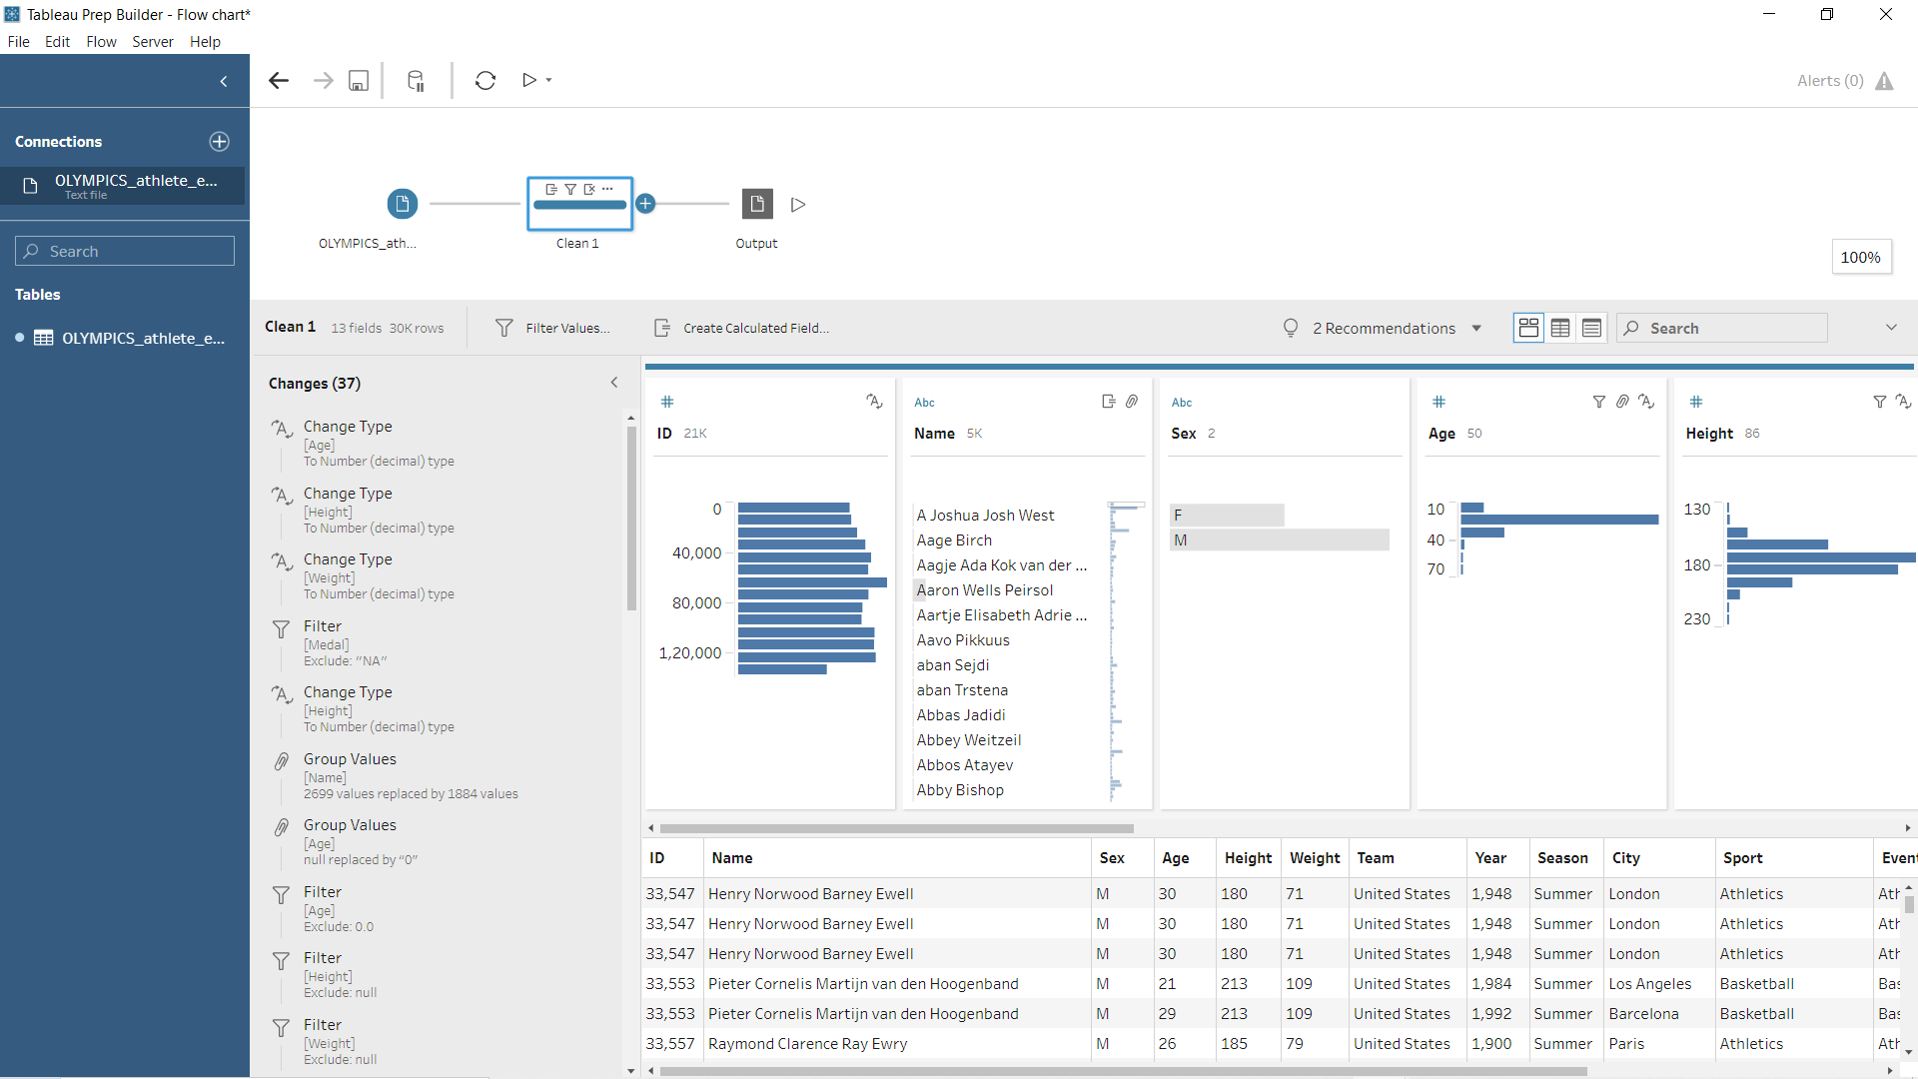
CLEANING STEP

Slide 10
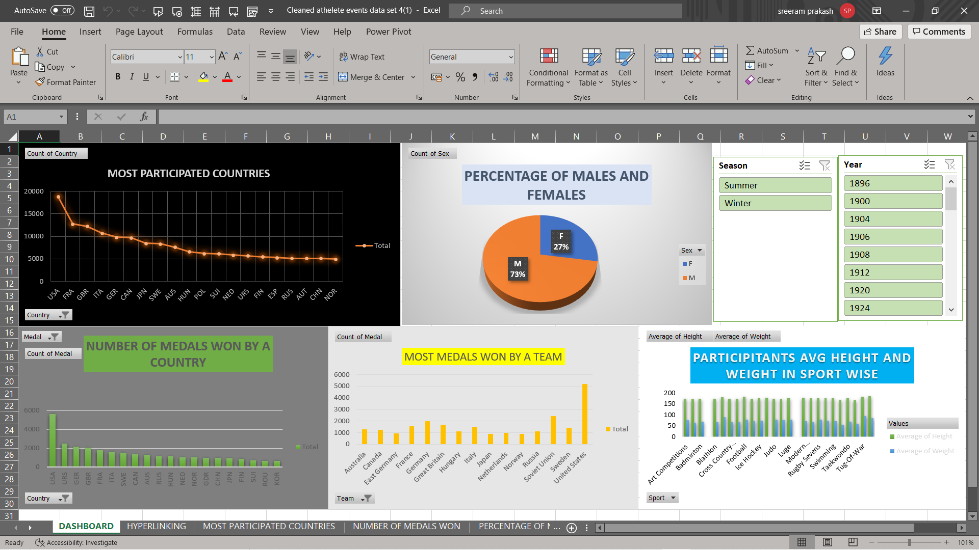
DATA ANALYSIS REPORT
DASHBOARD

Slide 11
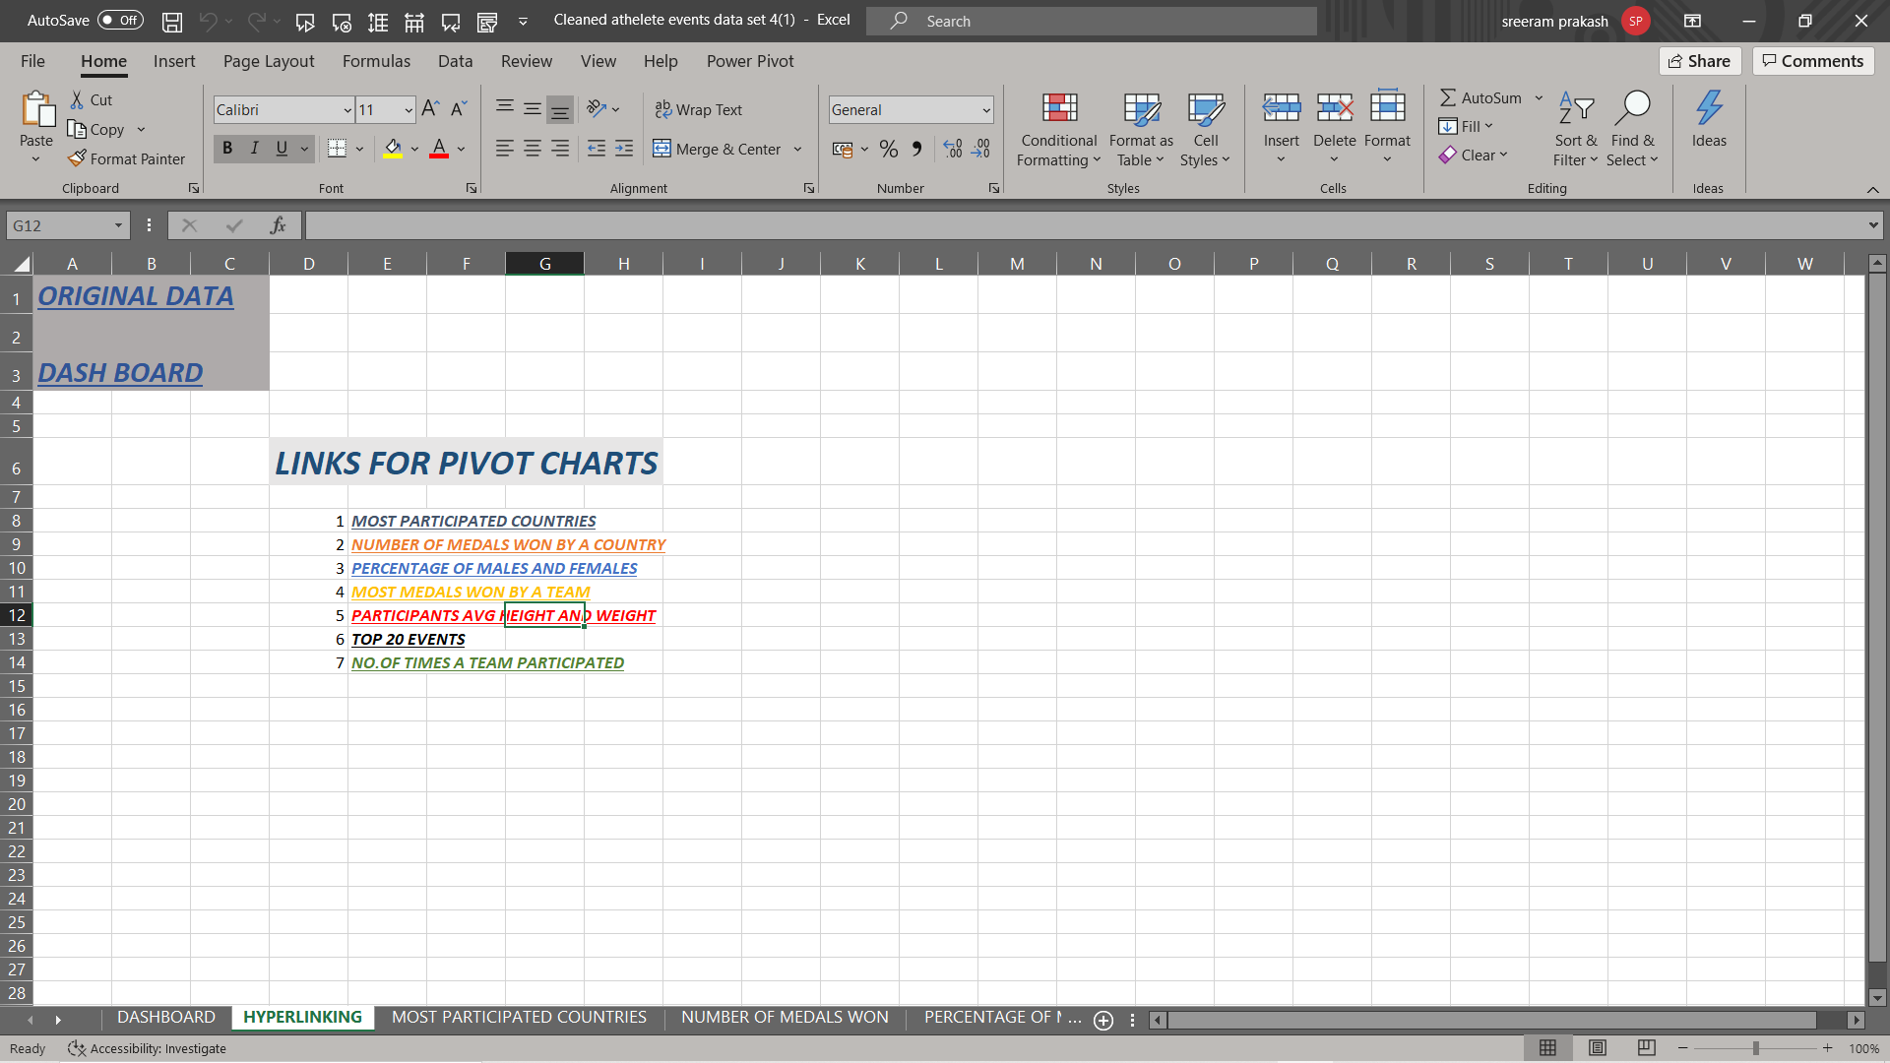
HYPERLINKING

Slide 12
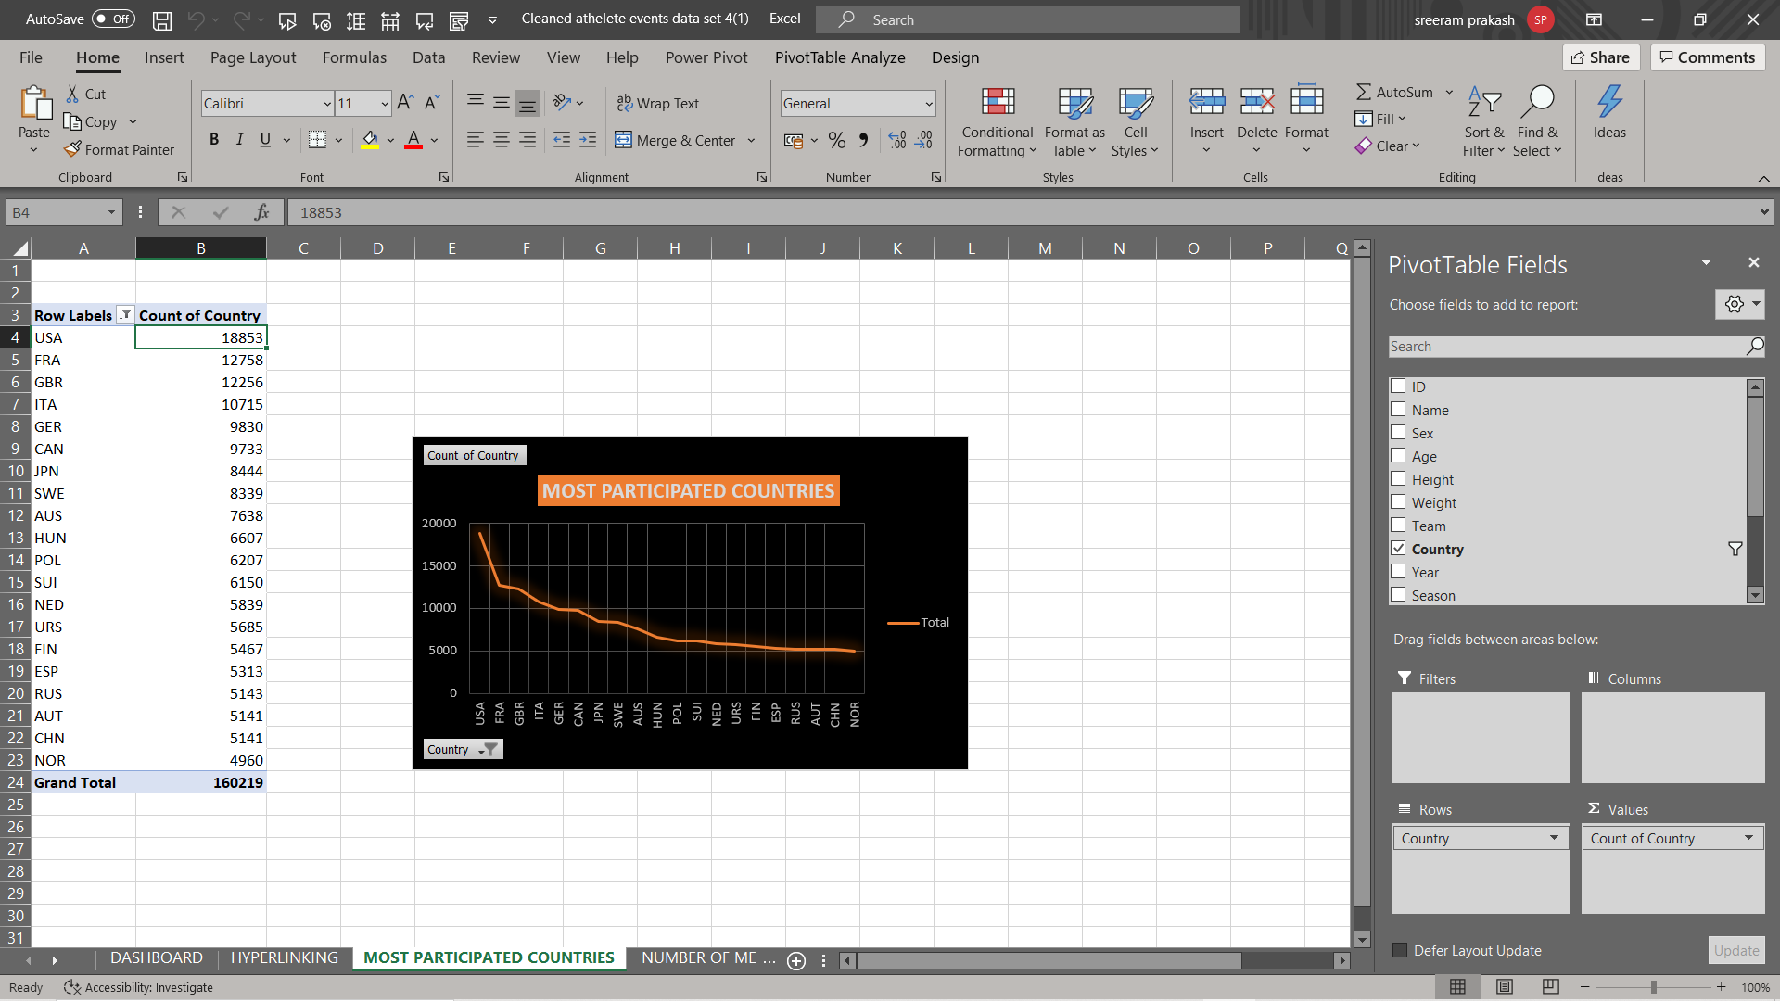
MOST PARTICIPATED COUTNRIES.

Slide 13
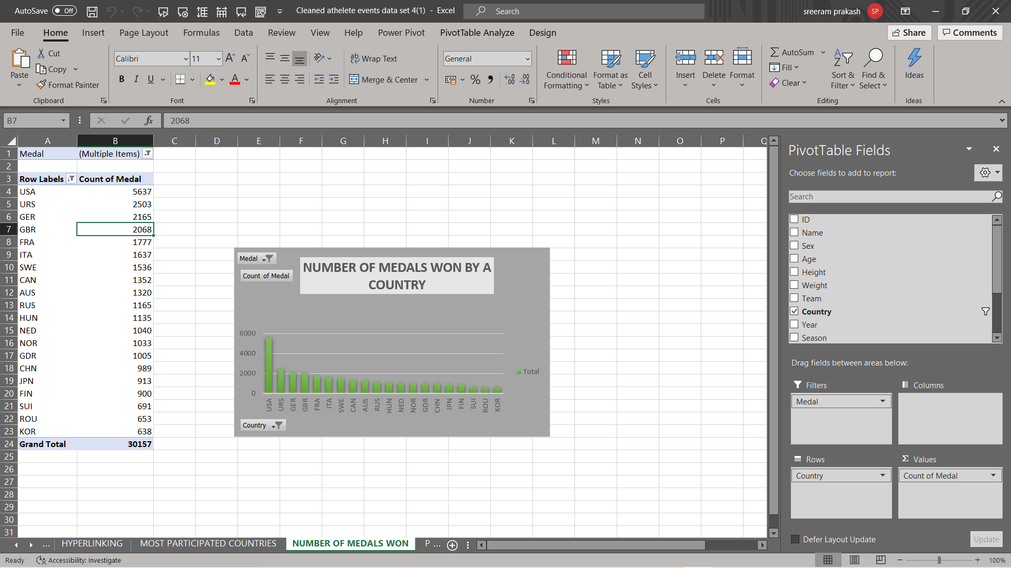
NUMBER OF MEDALS WON BY A COUNTRY.

Slide 14
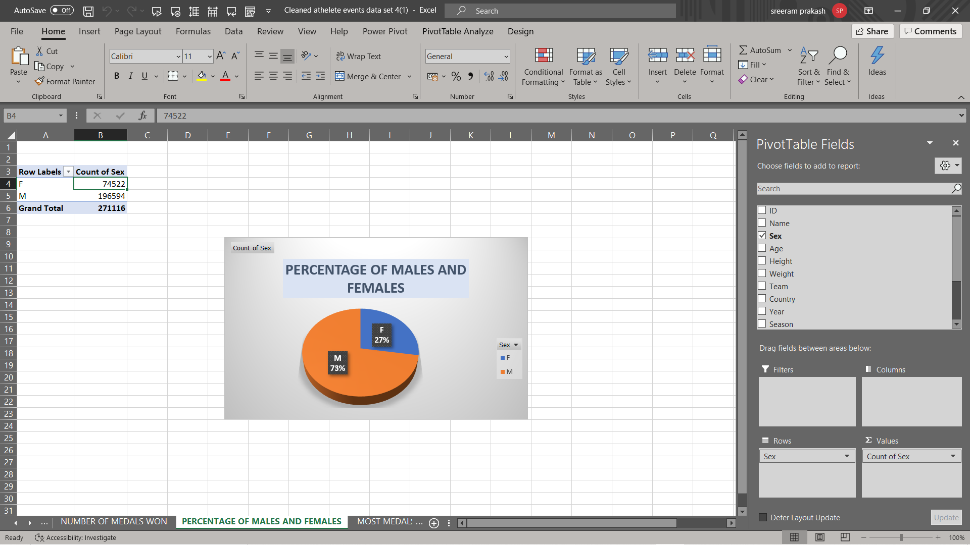
PERCENTAGE OF MALE AND FEMALE.

Slide 15
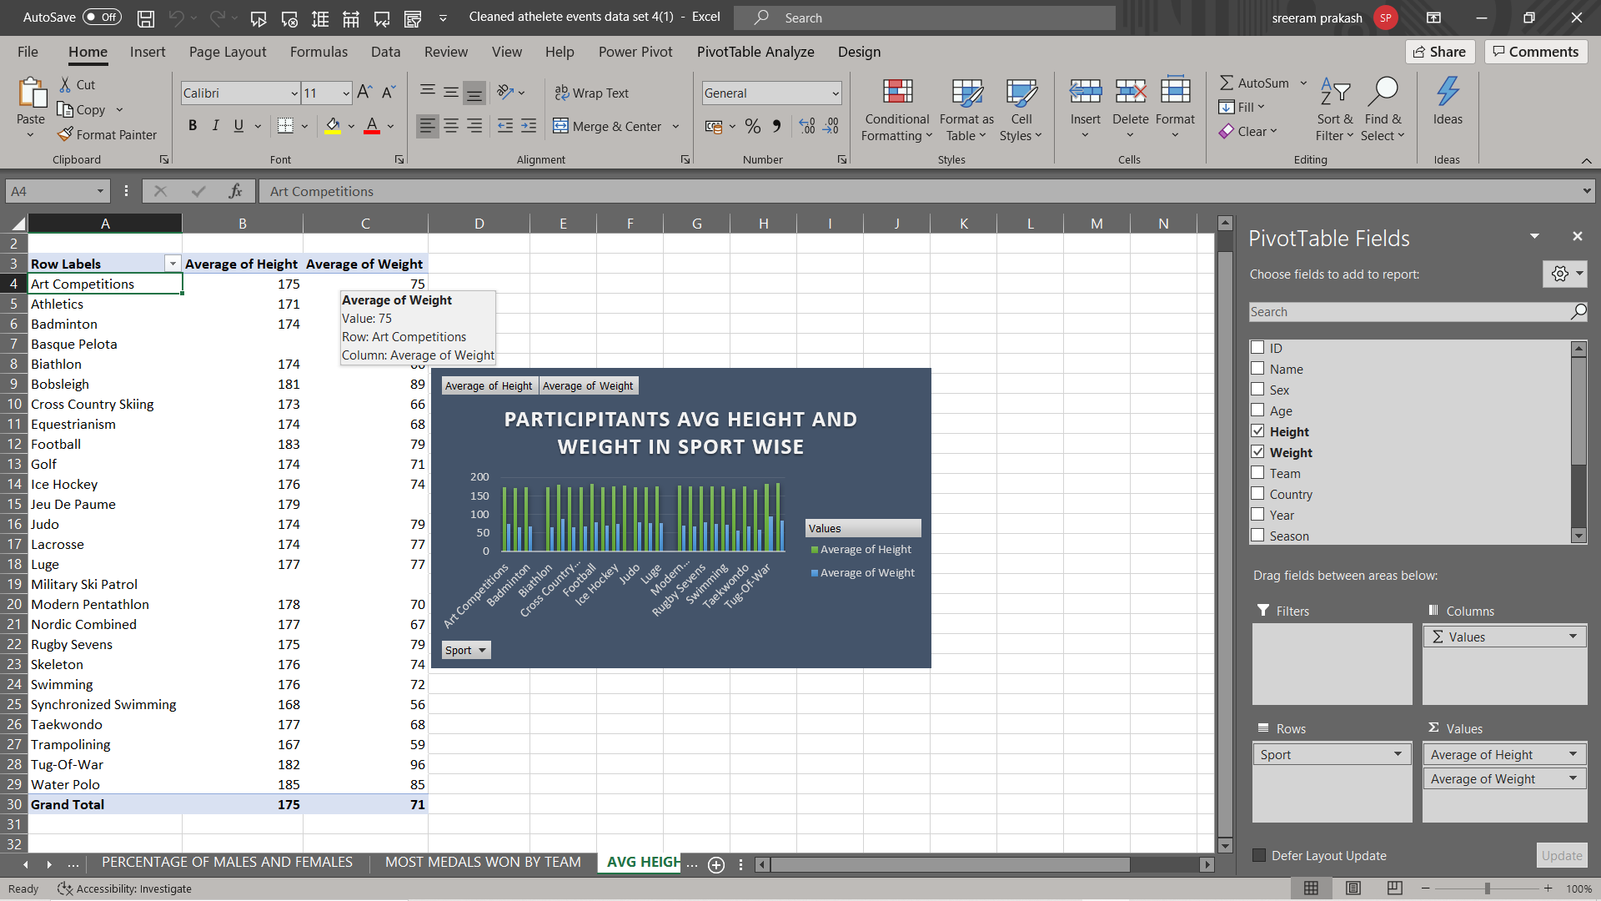
PARTICIPANTS AVG HEIGHT AND WEIGHT.

Slide 16
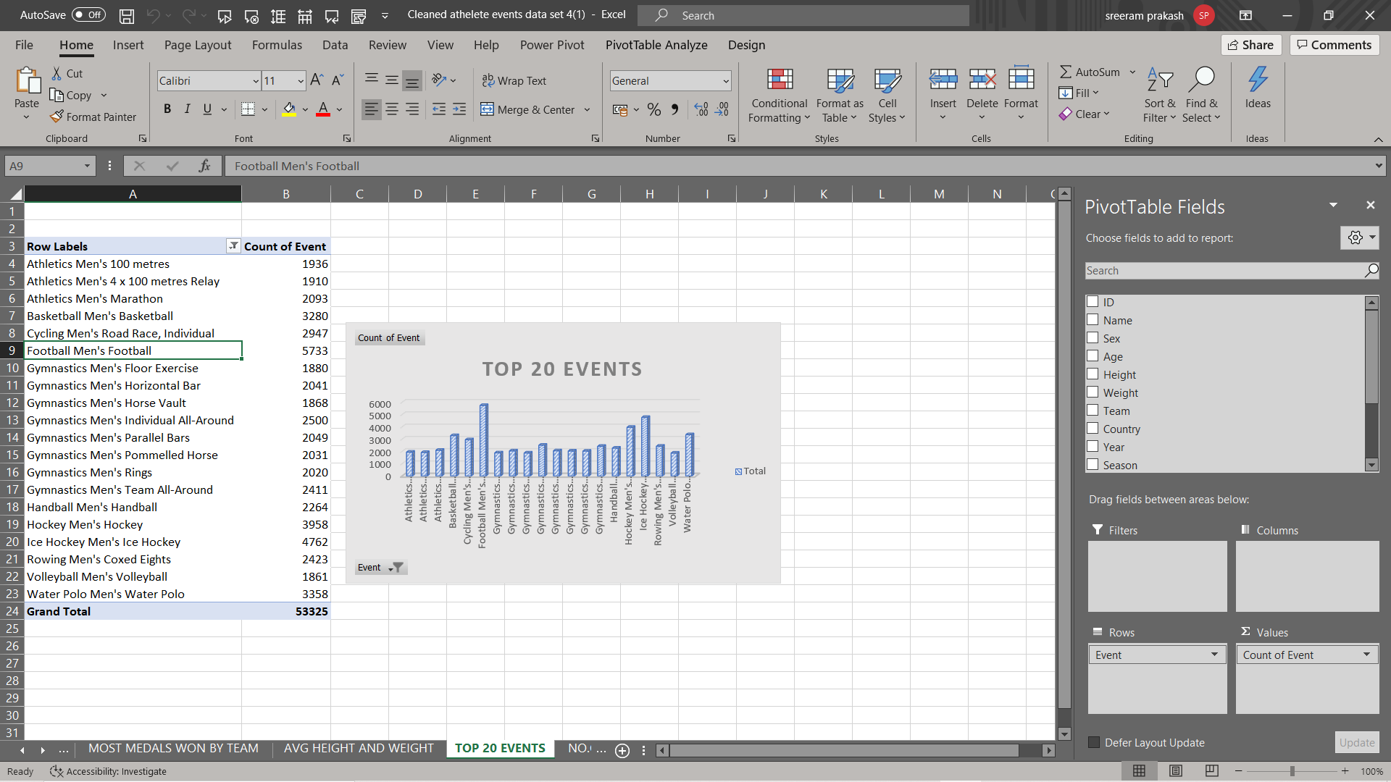
TOP 20 EVENTS.

Slide 17
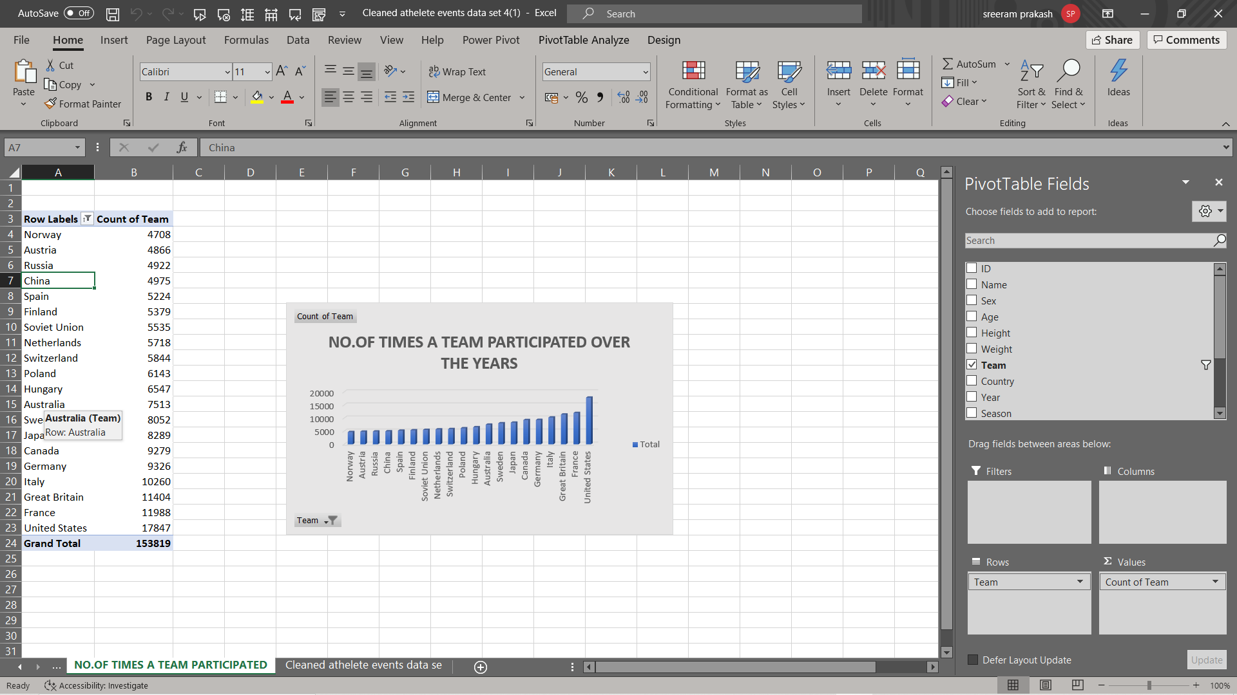
NO OF TIMES A TEAM PARTICIPATED.

Slide 18

THANK YOU

